Slide 1
Linear Regression

Slide 2
Linear Regression
Linear regression is used for finding linear relationship between target and one or more predictors.
There are two types of linear regression-
Simple
Multiple

Slide 3
Simple Linear Regression
Simple linear regression is useful for finding relationship between two continuous variables.
One is predictor or independent variable and other is response or dependent variable.
It looks for statistical relationship but not deterministic relationship.

Slide 4
Deterministic vs Statistical
Relationship between two variables is said to be deterministic if one variable can be accurately expressed by the other.
For example, using temperature in degree Celsius it is possible to accurately predict Fahrenheit.
Statistical relationship is not accurate in determining relationship between two variables.
For example, relationship between height and weight.

Slide 5

Linear Regression
The core idea is to obtain a line that best fits the data.
The best fit line is the one for which total prediction error (all data points) are as small as possible.
Error is the distance between the point to the regression line.
Y(pred) = b+ m*x
Y = b₀ + m₁b₁ + m₂b₂ + m₃b₃ + ... ... m_{n}b_{n}

Slide 6
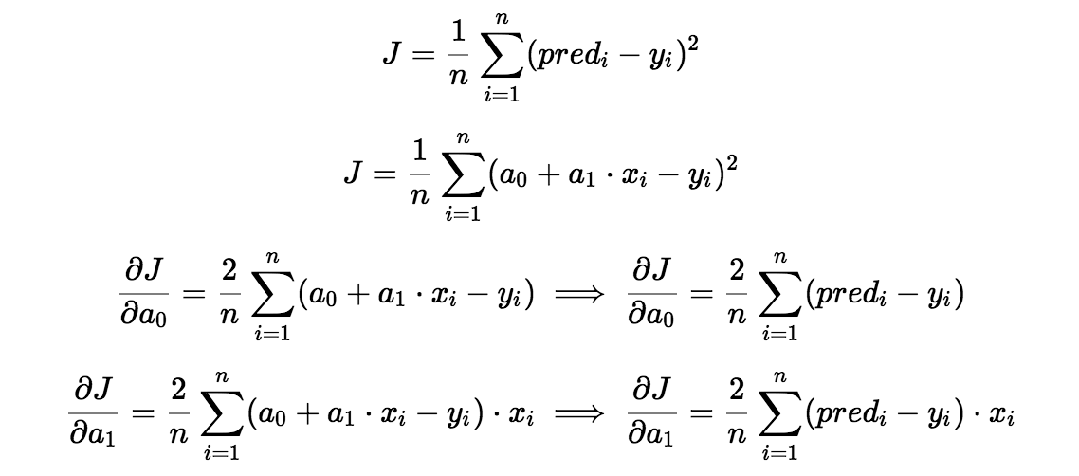
Gradient Descent

Slide 7
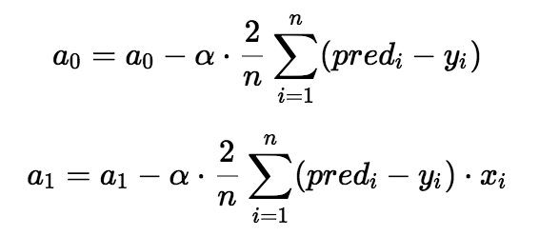
Gradient Descent

Slide 8
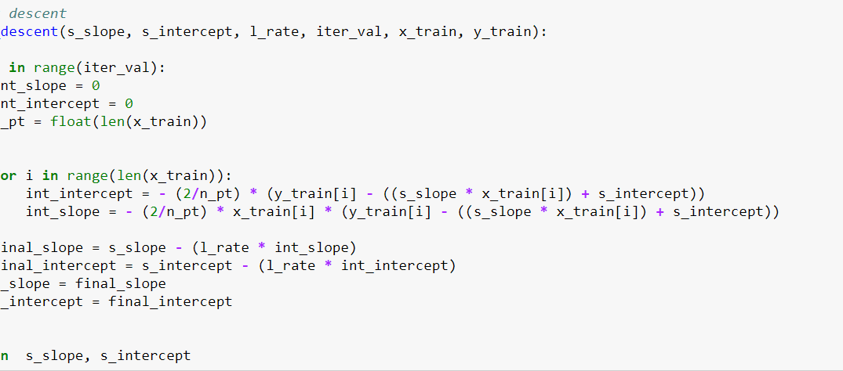
Code

Slide 9
Exploring ‘m’
If b1 > 0, then x(predictor) and y(target) have a positive relationship. That is increase in x will increase y.
If b1 < 0, then x(predictor) and y(target) have a negative relationship. That is increase in x will decrease y.

Slide 10
Exploring ‘b’
If the model does not include x=0, then the prediction will become meaningless with only b.
For example, we have a dataset that relates height(x) and weight(y). Taking x=0(that is height as 0), will make equation have only b value which is completely meaningless as in real-time height and weight can never be zero. This resulted due to considering the model values beyond its scope.
The value of b guarantee that residual have mean zero.
If there is no ‘b’ term, then regression will be forced to pass over the origin.
Both the regression co-efficient and prediction will be biased.

Slide 11
Residual Analysis
Randomness and unpredictability are the two main components of a regression model.
Prediction = Deterministic + Statistic
Deterministic part is covered by the predictor variable in the model.
Stochastic part reveals the fact that the expected and observed value is unpredictable.

Slide 12
Detecting residual pattern
Non-random pattern of the residual plot indicates that the model is,
Missing a variable which has significant contribution to the model target
Missing to capture non-linearity (using polynomial term)
No interaction between terms in model

Slide 13
Characteristics of a residue
Residuals do not exhibit any pattern
Adjacent residuals should not be same as they indicate that there is some information missed by system.

Slide 14
Problems with Model
Problem with outlier: Linear regression models are very sensitive to outliers in the data. Always try with removing outliers.
Need more data: Only one year worth of data isn't that much, whereas having multiple years worth could have helped us improve the accuracy quite a bit.
Bad assumptions: We made the assumption that this data has a linear relationship, but that might not be the case. Visualizing the data may help you determine that.
Poor features: The features we used may not have had a high enough correlation to the values we were trying to predict.

